Slide 1

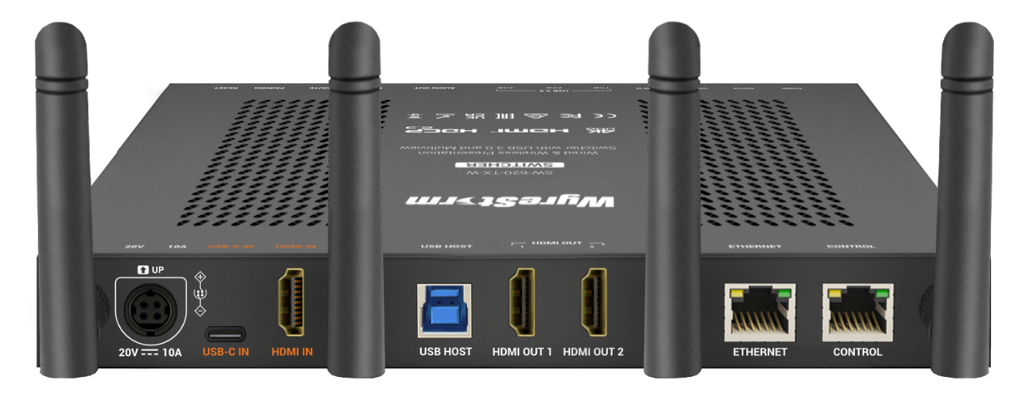

SW-620-TX-W
Product Guide
Wireless Presentation and Conferencing System
Award-Winning Audio-Visual Solutions Manufacturer
Notes:
1. 更新封面，不需要展示产品；

Slide 2

Contents
Product Overview & Key Features
Why Choose Us?
Interface & Specifications
Typical Connection & Applications
Comparison Analysis
Web UI Introduction
Q & A Session
Powerful · Reliable · Simple

Slide 3
Product Overview
2-Input 4K Wireless Presentation and Conferencing System
The ‘SW-620-TX-W’ is the lite version of ‘SW-640L-TX-W’ with some enhancement. It is a wireless presentation switcher, when paired with the APO-DG2 or APO-DG2-PRO USB-C casting dongle, forms a powerful 4K wireless presentation and conferencing system. This setup ensures a seamless and superior hybrid meeting experience.
Building on the strengths of its predecessors, the SW-620-TX-W features one full-function USB-C input, one HDMI input, and two HDMI outputs, offering flexible connectivity options for various setups. It is ideal for small to medium-sized meeting rooms and classrooms, effectively meeting diverse application requirements and enhancing collaboration efficiency.
Powerful · Reliable · Simple

Slide 4









Main Features
Reliable and High-Quality Resolution
4K resolution guarantees sharp and clear video, delivering a fully immersive presentation experience.
Multiview Support & Dual HDMI Outputs
Displays up to dual-view when connecting one screen. Supports dual HDMI outputs with two independent full-screen sources displayed simultaneously for maximum flexibility.
Comprehensive Input Options
Offers a variety of inputs, including USB-C and HDMI, ensuring compatibility with devices used in conferences, meetings, and educational settings.
Balanced Audio De-embedding
Independent de-embedding audio works seamlessly with external audio systems. It creates a more immersive audio experience for presenters and participants.
Full-Featured USB-C Support
The USB-C port provides power delivery, network, video, and USB transmission through a single cable, simplifying connections and maintaining a clean and tidy workspace.
KVM Switch for Display
Includes USB 3.0 (Device and Host) ports for cameras, speakerphones, and keyboards. Perfect for hybrid meetings and education.
Multi-Stream Transport(MST) Capability over USB-C
Supports USB-C MST technology, enabling simplified connections, reduced cabling, efficient resource utilization, and flexible multi-screen configurations
Versatile and Flexbile Ethernet
Advanced Ethernet capabilities provide a reliable network environment, enhancing interactive experiences, especially during hybrid meetings and education. Ethernet Bridge and Ethernet Isolation ensure a stable and secure usage experience.
Wireless Casting and Conferencing Support
Supports multiple presentation methods for classes or meetings, including Airplay mirroring, Miracast, and Dongle. In addition to wireless casting, it also support wireless conferencing through dongle integration.
Powerful · Reliable · Simple

Slide 5
Why Choose Us: 1. Easy Click Wireless Conferencing
Transform your meeting room with easy click wireless conferencing, ensuring easy connectivity, seamless integration, and enhanced productivity.
Effortless Connectivity
Seamless Integration
With just click on the APO-DG2/APO-DG2-PRO USB-C dongle, you can control your USB conferencing devices wirelessly, eliminating the hassle of tangled cables.
Seamlessly integrates with cameras, speakerphones, video bars, touch-screen panels, and other USB 3.0 peripherals, ensuring a superior hybrid meeting experience.
Boost Productivity
High-Quality Performance
Quickly transition between meetings with minimal setup time, ensuring a smooth and productive workflow.
Delivers clear and reliable audio-visual communication, critical for effective collaboration.
Powerful · Reliable · Simple

Slide 6
Why Choose Us: 2. Easy Sharing and Collaboration for Everyone
Simplify screen sharing and collaboration across multiple devices and operating systems, enabling seamless interaction and greater engagement.
Multiple Casting Methods
Universal Compatibility
Supports AirPlay Mirroring, Miracast, USB-C dongles, and HDMI/USB-C wired connections, offering flexible options for different users and devices.
Seamlessly works with laptops, tablets, and smartphones, supporting major operating systems including Windows, macOS, and Android.
Interactive Learning
Engage Your Audience
Ideal for classrooms, allowing teachers to easily share content and students to engage interactively using their own devices.
Multiview mode allows up to two sources to be displayed simultaneously, making collaboration and data comparison more intuitive and efficient.
Powerful · Reliable · Simple

Slide 7
Why Choose Us: 3. Plug & Play, Guest-Friendly
Simplify setup with plug-and-play functionality, making it easy for guests to connect and present without any hassle.
Simplified Setup
Versatile Input Options
Plug-and-play functionality allows guests to connect instantly with no need for additional software or complex configurations.
Equipped with one full-featured USB-C port (100W PD for guests’ laptops) and one HDMI input, it offers maximum flexibility for diverse presentation needs.
Present in Seconds
Secure Network Access
Guests can simply pick up the dongle and start sharing instantly, ensuring a smooth and efficient presentation experience.
Switch to “Isolated Mode” when you need to separate your internal network from the guests’ network. This mode ensures secure and reliable guest access, even during system configuration.
Powerful · Reliable · Simple

Slide 8
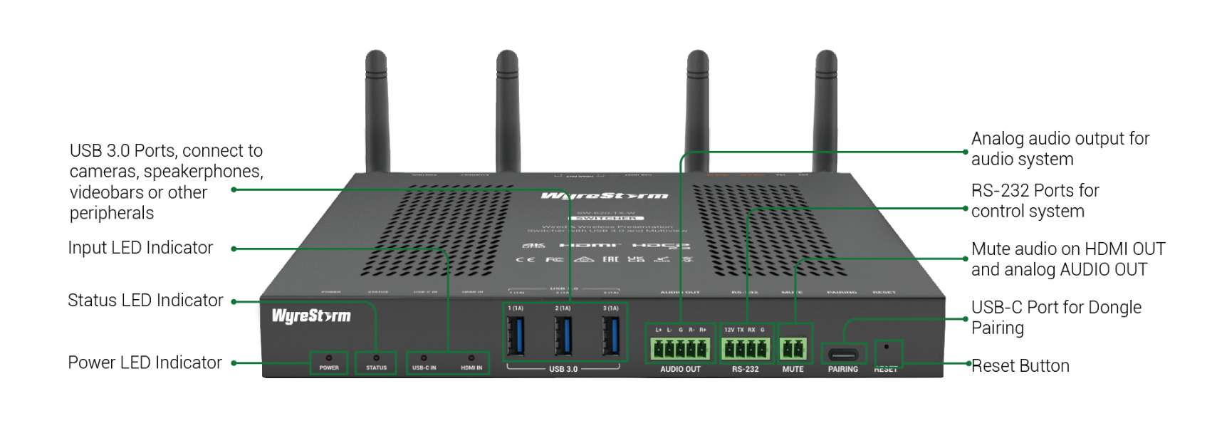
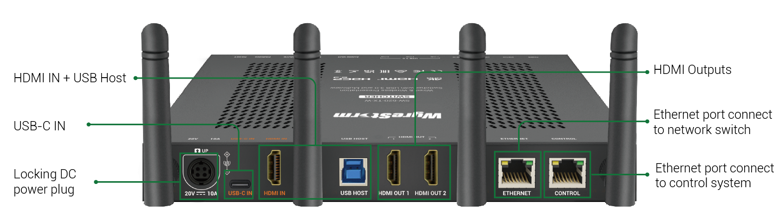
Interface of the Product
Front Panel
Featuring:
Advanced USB-C Integration
It provides not only video, audio, and USB signals, but also 100W power delivery, stable network access, and MST capability.
Multiple Wired Network Connectivity
Offers multiple wired connections including USB-C, USB Host, and Ethernet (in non-isolated mode), ensuring stable and reliable network performance for AV applications.
Rear Panel
Powerful · Reliable · Simple

Slide 9
Specifications & Packing List
Main Specifications
Input Video Port | Wired: 1x USB-C, 1x HDMI Wireless: Miracast, Airplay, Dongle(APO-DG2/APO-DG2-PRO)
Max. Input Resolutions | USB-C/HDMI: 4K@30Hz Miracast: 1080P@60Hz Airplay Mirroring: 1080P@60Hz Dongle: 4K@30Hz
Output Video Port | 2x HDMI
Max. Output Resolutions | HDMI OUT 1: 4K@60Hz HDMI OUT 2: 4K@30Hz
Input Audio Port | 1x HDMI, 1x USB-C, 2x LAN, 2x Wi-Fi
Output Audio Port | 2 x HDMI, 1 x Analog Audio Out
USB Device | 3x USB3.0 Type-A
Control Method | Web UI, Telnet API, RS-232
Power Supply | 20V 10A DC
What’s in the Box?
1x SW-620-TX-W
1x 20V/10A Power Supply
4x AC cables, US, EU, UK, AU specification
4x Plastic Mounting Brackets
1x 2-pin Phoenix Connector (for MUTE port)
1x 4-pin Phoenix Connector (for RS-232)
1x 5-pin Phoenix Connector (for Audio Out)
4x Wi-Fi Antennas
1x Quick Start Guide
Powerful · Reliable · Simple

Slide 10
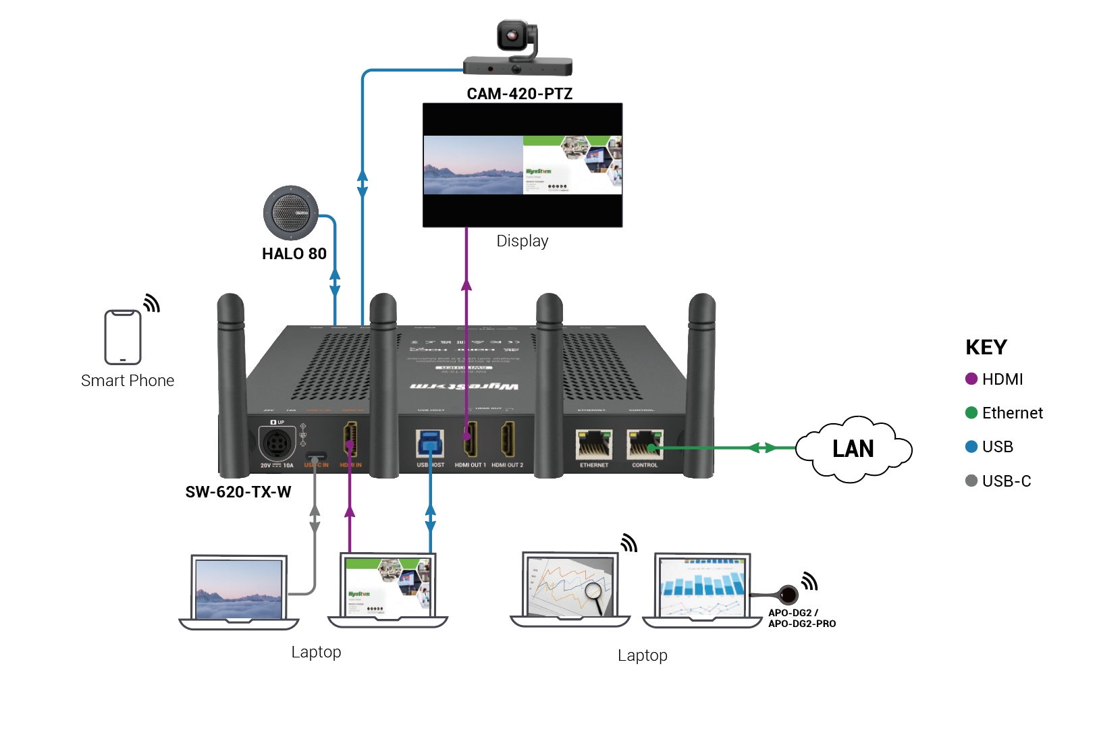
Typical Connection & Applications
The SW-620-TX-W system seamlessly integrates with all your conferencing equipment, such as room PCs, laptops, displays, webcams, speakerphones, and amplifiers. It’s designed to meet all your needs for high-quality video presentations and remote conferencing. See the typical connection diagram below for reference.

Slide 11
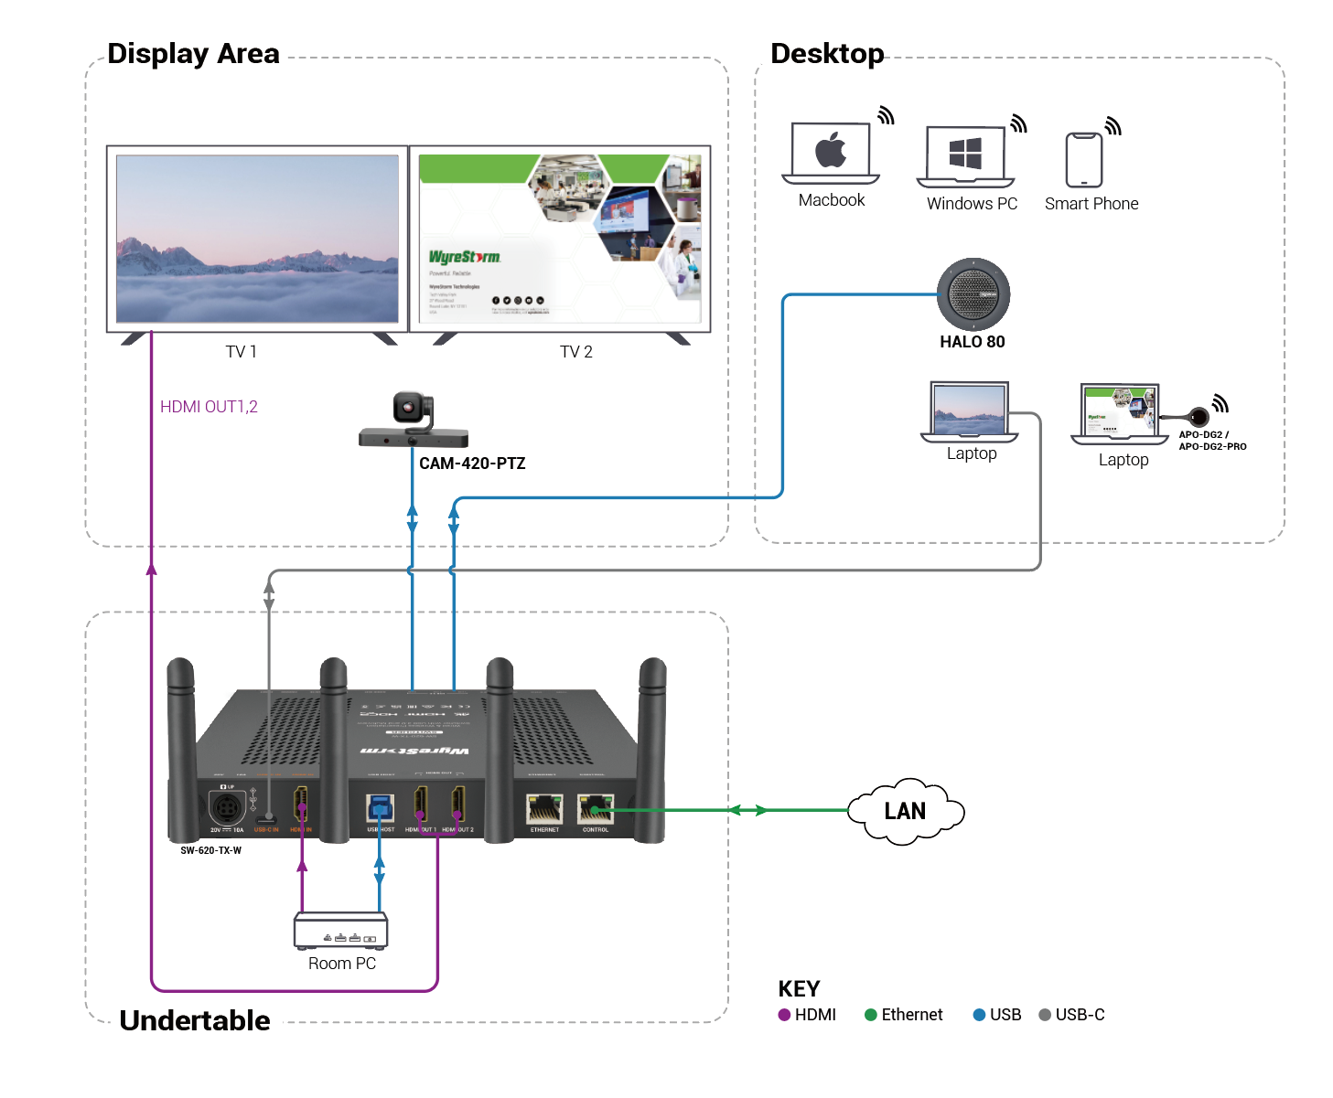
Typical Connection & Applications
Application Scenario 1: Small Classroom
This solution empowers teachers to easily share teaching content and engage students who can participate using their own devices. It enhances classroom interactivity and improves teaching efficiency.
Key Benefits Include:
Full-Featured USB-C Supported: Provide video, audio, USB3.0, Ethernet, and 100W charging with one cable.
MST Capacity over USB-C: Enable multi-display extension through a single cable, delivering a cleaner setup and more efficient content sharing.
Multiple Casting Methods: Simplifies presentations with various casting options.
Dual-Screen Connection: Ensures clear and comprehensive display.
Fast Seamless Switching: Quick and smooth transitions between inputs.

Slide 12
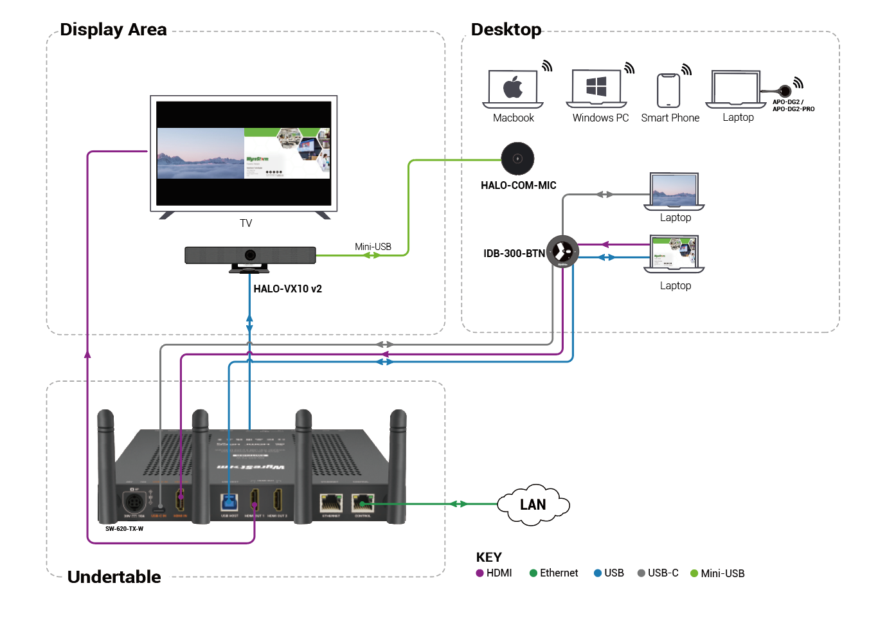
Typical Connection & Applications
Application Scenario 2: Medium Conference Room
This solution simplifies installation with its plug-and-play design, significantly enhancing meeting efficiency for both in-person and remote conferencing, ensuring every meeting is productive and smooth.
Key Benefits Include:
Advanced USB-C Supported: Provide video, audio, USB3.0, Ethernet, and 100W charging with one cable.
Multiple Casting Methods: Simplifies presentations with various casting options.
Multiview Function: Synchronous display of multiple information sources.
Fast Seamless Switching: Quick and smooth transitions between inputs.

Slide 13
Comparison with Other Competitors
 |  | WyreStorm SW-620-TX-W | Barco CX-50 Gen 2 | Creston AM-3200-WF | BlueStream WMF72 | Extron Share Link Pro 2500
Video Feature | Video Input | 1x HDMI 1x USB-C (Video, USB, Ethernet, 100W Charging) | 1x USB-C (Video only) | 1x HDMI | 1x HDMI 1x USB-C(Video, USB, Ethernet, 65W charging ) | 1x HDMI
 | Max. Input Resolution | 4K@30Hz | 4K@30Hz | 1080P@60Hz | Not Given | 4K@30Hz
 | Video Output | 2x HDMI | 1x HDMI or 1x USB-C | 1x HDMI | 2x HDMI | 2x HDMI
 | Max. Output Resolution | 4K@60Hz | 4K@60Hz | 4K@60Hz | 4K@60Hz | 4K@60Hz
Wireless Collaboration | Max. Dongle Casting Resolution | 4K@30Hz | 4K@30Hz | 4K@30Hz | 4K@30Hz | Support, Resolution not given
 | Max. Wireless Conferencing Resolution* | 1080P@30Hz | 720P@15Hz | 720P | 1080P@30Hz | Support, Resolution not given
USB Feature | USB Host | 1x USB 3.0 Type-B 1x USB 3.0 Type-C | N/A | 1x USB 3.0 Type-B | 1x USB 3.0 Type-C 1x USB 3.0 Type-B | N/A
 | USB Device | 3x USB 3.0 Type-A | 2x USB 3.0 Type-A 1x USB 3.0 Type-C | 1x USB 3.0 Type-A 1x USB 2.0 Type-A | 3x USB 3.0 Type-A 2x USB 2.0 Type-A | 2x USB 3.0 Type-A
Network Feature |  | 2x RJ45 (Supports network isolation) 1x USB-C & 1x USB3.0 Type-B (Wired network to laptop) | 1x RJ45 | 2x RJ45 | 2x RJ45 1x USB-C (Wired network to laptop) | 2x RJ45
Multiview Feature |  | Dual View | Dual View | Quad View | Quad View | Quad View
*Max. resolution that USB camera can transmit wirelessly to your host by Dongle

Slide 14
Comparison with Wyrestorm Wireless Conference System
 |  | SW-620-TX-W | SW-640L-TX-W | SW-220-TX-W
Video Feature | Video Input | 1x HDMI 1x USB-C (Video, USB, Ethernet, 100W Charging, MST) | 2x HDMI 2x USB-C(Video, USB, Ethernet, 60W Charging, MST) | 1x HDMI 1x USB-C
 | Max. Input Resolution | 4K@30Hz | 4K@30Hz | 4K@30Hz
 | Video Output | 2x HDMI | 2x HDMI | 1x HDMI
 | Max. Output Resolution | 4K@60Hz | 4K@60Hz | 4K@30Hz
Wireless Collaboration | Wireless Casting Dongle | APO-DG2/APO-DG2-PRO | APO-DG2/APO-DG2-PRO | APO-DG1
 | Max. Dongle Casting Resolution | 4K@30Hz | 4K@30Hz | 1080P@30Hz
 | Wireless Conference | Supported | Supported | -
 | Max. Wireless Conferencing Resolution* | 1080P@30Hz | 1080P@30Hz | -
USB Feature | USB Host | 1x USB 3.0 Type-B 1x USB 3.0 Type-C | 2x USB 3.0 Type-B 2x USB 3.0 Type-C | 1x USB 2.0 Type-C
 | USB Device | 3x USB 3.0 Type-A | 3x USB 3.0 Type-A | 2x USB 2.0 Type-A
Network Feature |  | 2x RJ45(Supports network isolation)​ 1x USB-C&1x USB3.0 Type-B​ (Wired network to PCs) | 3x RJ45(Support network isolation)​ 2x USB-C(Wired network to PCs)​ | 1x RJ45
Multiview Feature |  | Dual View | Quad View | Dual View
*Max. resolution that USB camera can transmit wirelessly to your host by Dongle

Slide 15
Our Advantages
This versatile system is designed for conference rooms and classrooms, meeting diverse signal transmission requirements. It delivers efficient, high-quality performance for seamless presentations and hybrid collaboration.
Our key advantages include:
Full-Featured USB-C Port: Transmits video, audio, USB data, Ethernet (1G), and up to 100W power delivery through a single cable.
Multiview Support: Displays up to two views simultaneously on one screen connection for flexible content sharing.
Dual Ethernet Ports: Provide secure, stable network access for guest PCs and enable simple system configuration through a web interface.
Dual HDMI Outputs: Offer flexible display configurations for different room setups.
Cost-Effective Solution: Combines multiple functions in one system, delivering excellent value at a competitive price.
Powerful · Reliable · Simple

Slide 16

Introduction of Web Configuration Interface
The Web UI of the SW-620-TX-W presentation system is designed for intuitive device management and configuration through any web browser.
The settings and configurations you can perform are as follows:
Web UI Functionality:
Interface: Manage device settings via web browsers.
Customization: Personalize splash screen and network security.
Control: Configure video inputs, outputs, and wireless settings.
Key Web UI Configurations:
General Settings: IP configuration, security, and firmware updates, like modifying the device name, or the device’s Wi-Fi hotspot name, setting the access code, etc.
Video Inputs/Outputs: Manage HDMI sources and EDID profiles.
Screen Sharing: Enable wireless display or multiview features.
Display Control: Use CEC and RS-232 for display management, customize the guide screen picture, etc.
Powerful · Reliable · Simple

Slide 17

Final Thoughts
Q & A Session
Got questions? Don't hesitate to ask away.
Powerful · Reliable · Simple

